Slide 1
Passenger Evaluation In College Bus Using Machine Learning

Slide 2
AGENDA
Abstract
Problem Statement
Introduction
Objectives
Motivation
Scope
Literature Survey
Overview Diagram
Proposed Methodology
Mathematical Model
Algorithms or Architecture
Hardware & Software
Applications &Benefits
Dataset Description
Result Evaluation
conclusion
Future Scope
References
Publications

Slide 3
Abstract
Maintenance of attendance in college bus is an important issue of every colleges since it is one of the primary ways to check the regularity of every student.
Attendance in college bus is done by maintaining the attendance sheet which is a time-consuming procedure.
Utilization of the same time may help the student to get some more information from the instructor.
Using of the deep learning enhances the process of automatic passenger evaluation system in college bus through Convolution neural network

Slide 4
Problem Statement
To enhance the process of passenger evaluation system in college bus, proposed model is using Convolution neural network and Image Segmentation process.

Slide 5
Introduction
Automatic attendance system in college bus
Preprocessing
Image Segmentation
Convolution Neural Network
Decision Making

Slide 6
Motivation
Attendance to be marked by grabbing student image
Implementing CNN is always a tough task
Challenging task of handling live images
To generate an in-depth Report to access the Passenger details
To bring down the whole idea into the reality

Slide 7
Objectives
To achieve the effective capturing of the frames from the live video stream.
To understand and implement the concept of image processing.
To effectively utilize the captured image of the individuals through the use of machine learning to achieve the accurate attendance system in college bus to evaluate the passenger

Slide 8
Scope
Experiment will be done on moderate and large dataset
System is deployed in a standalone simulated environment.
Testing is done while Student is entering into the bus

Slide 9
Literature Survey
Paper | Author | Methodology
Authenticating Corrupted Face Image Based on Noise Modela | Ho-Choul Jung, Bon-Woo Hwang and Seong-Whan Lee | Proposed a method for authenticating corrupted face images based on noise model. The proposed method first generates corrupted images by controlling noise parameters in the training phase. The corrupted images and noise parameters are represented by a linear combination of prototypes of the corrupted images and the noise parameters. With the corrupted image and an original image, they can estimate noise parameters of the corrupted face image in the testing phase

Slide 10
Literature Survey
Paper | Author | Methodology
The Application and Implementation of Face Recognition in Authentication System For Distance Education | Qianqian Zhao and Mali Ye | Proposed that facial feature extraction based on DCT and face recognition approach of P2D-HMM are used to authenticate to solve the problems existed in current distance education system in this paper. Furthermore, it designed and implemented a face recognition system and tested the system's recognition rate. The results showed that this method could solve the issue of many people sharing the same account to some extent, and improve the credibility of the remote examination evaluation in remote education

Slide 11
Literature Survey
Paper | Author | Methodology
Face Localization and Authentication Using Color and Depth Images | Filareti Tsalakanidou, Sotiris Malassiotis, and Michael G. Strintzis | Presented a face authentication system integrating 3-D range data and 2-D color or grayscale images. Novel algorithms for face detection and localization are proposed, that exploit depth information to achieve robustness under background clutter, occlusions, face pose, and illumination variations. Face authentication is based on the well-known EHMM method, which is also applied to range images

Slide 12
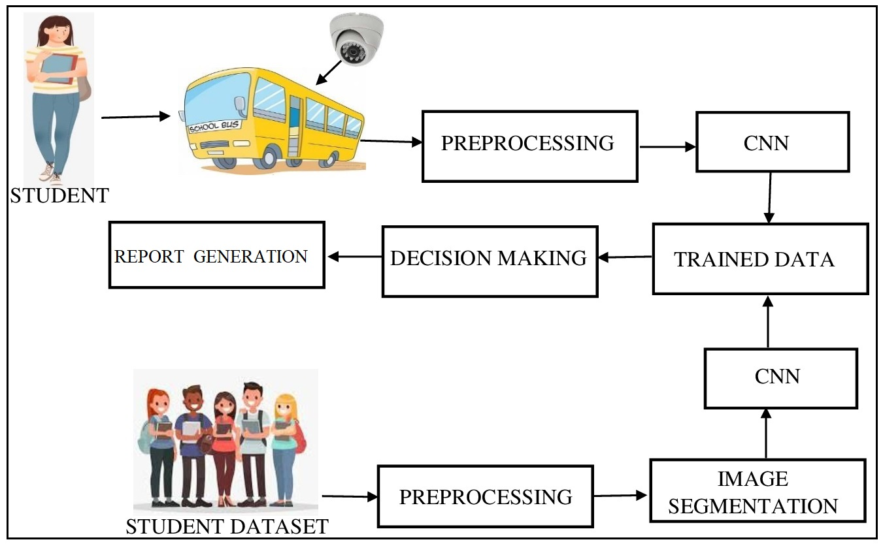
Block Diagram

Slide 13
RESEARCH METHODOLOGY
The proposed methodology of our system can be explained through following modules:
Module A: Preprocessing
  Input: Student Face Image Dataset
  Process: Rescaling
  Output: Preprocessed image
Module B: Image Normalization
  Input: Preprocessed Image
  Process: Training and Testing Data Generation
  Output: Data Generation List

Slide 14
RESEARCH METHODOLOGY CONT..
Module C: Convolutional Neural Networks
  Input: Data Generation List
  Process: Convolutional Neural Networks
  Output: Trained Model Data in .h5 file
Module D: Decision Making
  Input: Test Image
  Process: CNN Model Data
  Output: Student face authentication and Unknown person notification

Slide 15
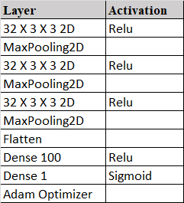
CNN Architecture Diagram

Slide 16
HARDWARE AND SOFTWARE
Minimum Hardware Specification :
( 1 Machine is Required of the Following Configurations)
  CPU : Core i5
  RAM : 8 GB
  HDD : 500 GB
Software Specification:
  Coding Language : Python,Java
  Development Kit : Python 3.8, JDK 1.8
  Front End : Tkinter, Java Swings
  Development IDE : Spyder 3.9, Netbeans 8.2
  Database : Mysql Server 5.2

Slide 17
Application and Benefits
Application
College bus
School bus, Corporate bus services
Benefits
Cost effective
Time saving
Curbing Illegal Activities by the bus drivers
Enhancing security

Slide 18
ASSUMPTION AND DEPENDENCIES
ASSUMPTIONS
System is deployed in single machine.
Size of the dataset is moderate
Student images are pre-trained
Dependencies
System speed
IDE behavior
Image Quality

Slide 19
Results
Put your output Screenshots here :

Slide 20
Conclusion
Accurate capturing of the student face through the camera
Successful training of the data through deep learning model convolution neural network
Effective identification of the student and unknown person entering into the bus through the live feed and implementation of deep learning methodologies
Accurate maintenance of the report data

Slide 21
FUTURE SCOPE
The Proposed model can be deployed in real time cloud using the RDS services and raspberry pie model in the buses to evaluate the passenger in real time.

Slide 22
REFERENCES
Ho-Choul Jung; Bon-Woo Hwang; Seong-Whan Lee,” Authenticating corrupted face image based on noise model”, Sixth IEEE International Conference on Automatic Face and Gesture Recognition, 2004. Proceedings.
Qianqian Zhao and Mali Ye, "The application and implementation of face recognition in authentication system for distance education," 2010 International Conference on Networking and Digital Society, 2010, pp. 487-489, doi: 10.1109/ICNDS.2010.5479246.
F. Tsalakanidou, S. Malassiotis and M. G. Strintzis, "Face localization and authentication using color and depth images," in IEEE Transactions on Image Processing, vol. 14, no. 2, pp. 152-168, Feb. 2005, doi: 10.1109/TIP.2004.840714.

